Slide 1
Machine Learning Homework
——Geek Eagle
2022.6.9

Slide 2
Catalogue
Ⅰ: Background introduction
Ⅱ: Subject analysis
Ⅲ: Conceptual design
Ⅳ: Data processing
Ⅴ: Model introduction
Ⅵ: Experimental result analysis
Ⅶ: Conclusion and outlook

Slide 3
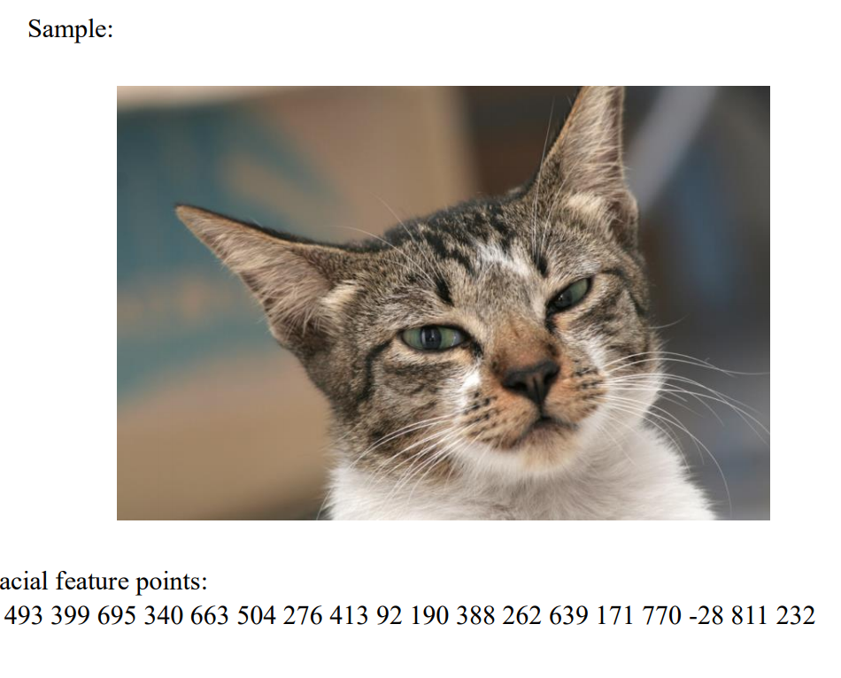
Ⅰ:Background introduction
This problem is a regression problem. The task is to input a cat picture to identify the cat's eyes, mouth and ears. There are two detection points for each eye and mouth, and three detection points for each ear. It belongs to supervised learning. Each picture has a corresponding label. The model adjusts parameters according to the label, and then learns the expected results. There are 9 identified points, and each point is composed of X Y two-dimensional coordinates, that is, a total of 18 data, so each output prediction result is an 18 dimensional vector.

Slide 4
Ⅱ: Subject analysis
2.1 Unified data format
To realize the function of this experiment, the model should learn the features of the picture and predict the coordinates of the feature points. First, the data set should be processed. Different photos should be uniformly changed to 227*227*3 size. When changing the picture size, the coordinate values of key points should also be modified according to the corresponding proportion.

Slide 5
Ⅱ: Subject analysis
2.2 Suitable model and setting hyperparameter value
The next step is to design the model. The size of the model should be appropriate. There are many too large model parameters, which will be fitted after several iterations. When designing the model, pay attention to the number of channels and the number of Fully Connected layers. If there are too many channels and the amount of data is small, it is easy to cause gradient smoothing
During training, pay attention to setting an appropriate learning rate, which is generally about 0.0001-0.01. Too large a learning rate is easy to cause Nan, and too small a learning rate is not good. The output data can judge the accuracy and variance of the model by calculating the loss function of the training set and the test set.
Finally, the prediction results, original pictures and coordinates should be output, so as to visually view the quality of model learning.

Slide 6
Ⅱ: Subject analysis
2.3 Outputs visualization
The output data can judge the accuracy and variance of the model by calculating the loss function of the training set and the test set. Finally, the prediction results, original pictures and coordinates should be output, so as to visually view the quality of model learning.

Slide 7
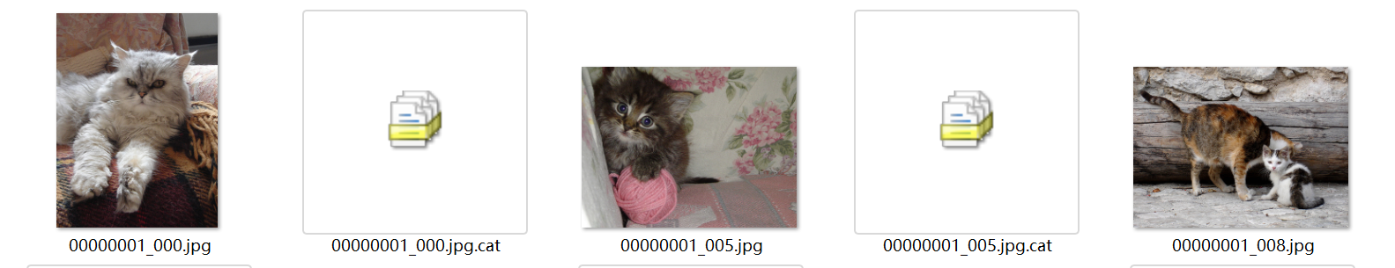
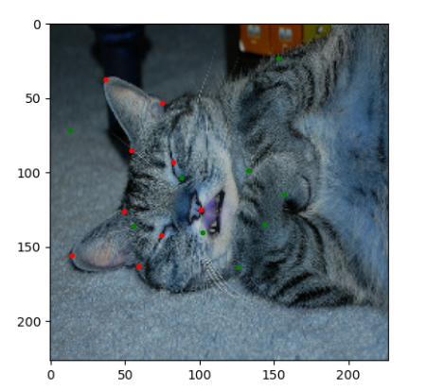
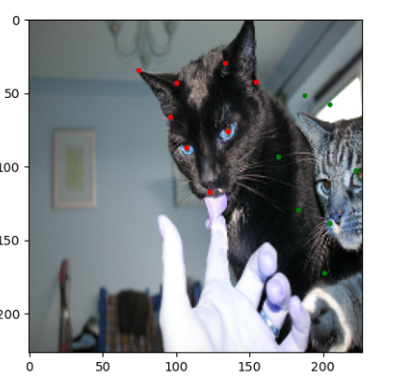
Ⅲ: Conceptual design
3.1 resize the width and length of picture &
change the label value with picture size
Before pre-precess Each picture has different size
after pre-process
Unified the size of pictures and p position values

Slide 8
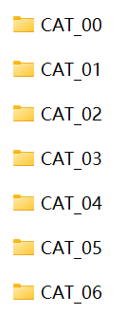
Ⅲ: Conceptual design
3.2 Divide training set, validation set and test set
Training set is used to fit the model and train the classification model by setting the parameters of the classifier. Later, when combined with the verification set, different values of the same parameter will be selected to fit multiple classifiers.
Validation set is used by each model to predict the validation set data and record the accuracy of the model in order to find the best model after multiple models are trained through the training set. Select the parameters corresponding to the best model, that is, to adjust the model parameters.
The test set is used to measure the performance and classification ability of the optimal model. After the optimal model is obtained from the training set and the verification set, the test set is used to predict the model. When the model parameters have been determined, the test set is used to evaluate the model performance.
00-03: training set (about 60%)
04: validation set (about 10%)
05:test set (about 30%)

Slide 9
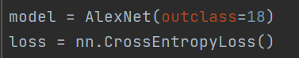
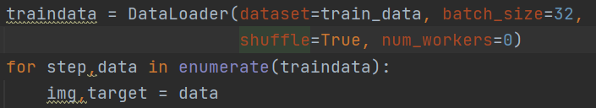
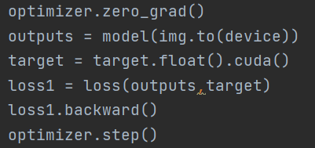
Ⅲ: Conceptual design
3.3 Input to model & train
Alexnet model is selected in this design, which is a classic CNN image recognition model. It is trained for 25 iterations. Each round of training adopts batch method, 32 pictures in each batch, and is based on CUDA calculation under pytorch framework. A 32*18 tensor type data is obtained for each training, which is the predicted value. The loss is calculated with the corresponding real value. The loss function adopts the cross entropy function, and then the parameters of each layer of the model are adjusted according to the loss.
Initialize model and loss: Load data:
Outputs, loss calculation and backward:
The information of model will be introduced in part V.

Slide 10
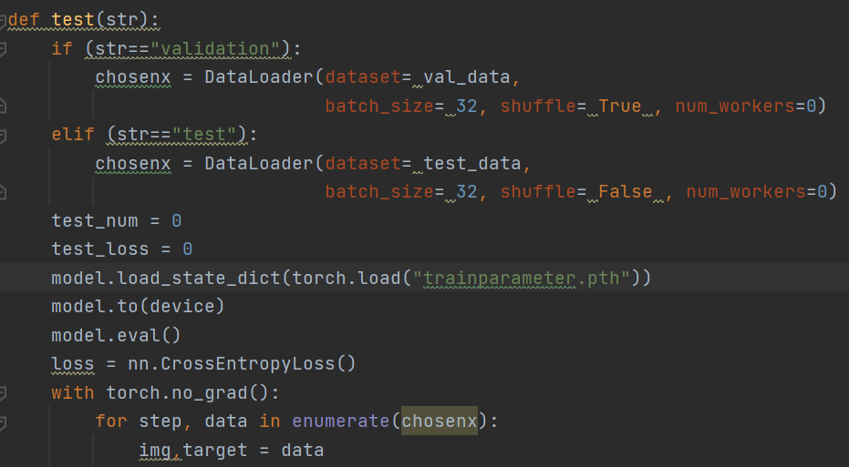
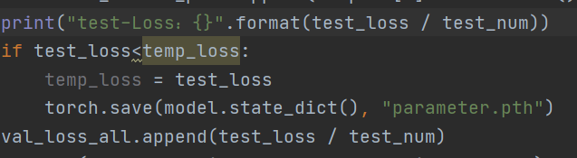
Ⅲ: Conceptual design
3.4 Validation, test & showing result
After training once, change the model to eval state, and run the validation set with the parameters to see the loss effect. After the training, test with the obtained parameters. In addition, in the training stage, the loss value of each time shall be recorded, and then the loss epoch curve shall be drawn according to the records. And select some pictures in a certain order to show the difference between the predicted value and the real value in the coordinate system, so as to evaluate the learning results of the model.
Set the model to the eval state
and run the validation set data
Save parameters that make test better

Slide 11
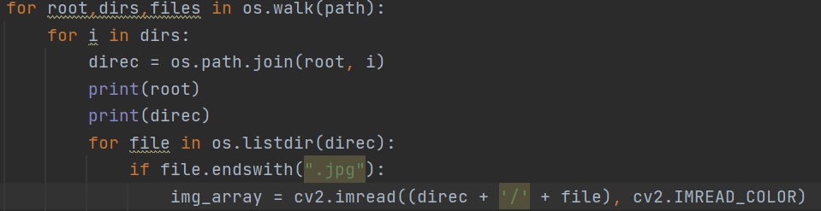
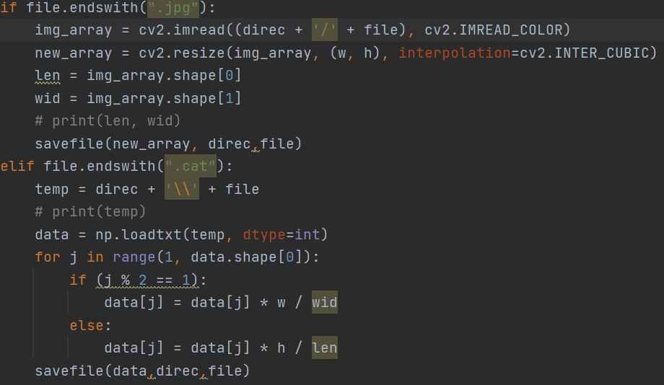
Ⅳ: Data processing
4.1 resize
The original data contains 9952 photos of cats, corresponding to 9952 cat face data. Each picture and data are arranged in order, and the file names correspond. The pictures in the original data are different in size and cannot be put into a CNN model. So read and modify the photo and tag values. In addition, os.walk (path), return the secondary directory direc, and then use os.listdir (direc) gets the name of each file, and then gets the path of the file through string combination, so you can read the file.
Read every picture: Resize the picture and label:

Slide 12
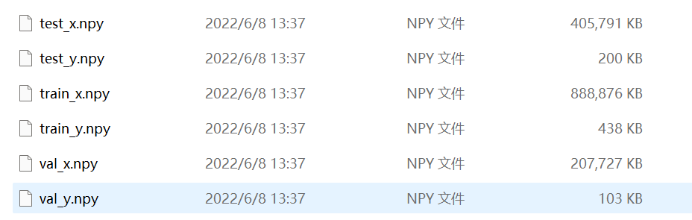
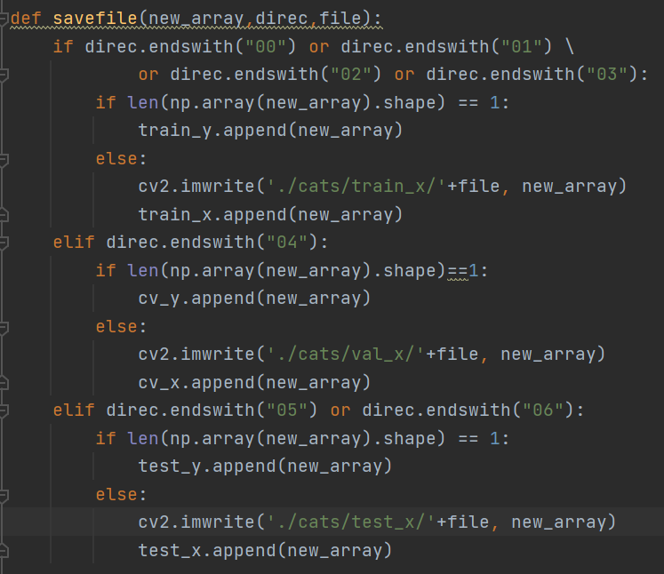
Ⅳ: Data processing
4.2 Divide training set, validation set and test set
Since the folder number under cats is from 00-06, the training set, verification set and test set can be divided according to the number. Because the data format of each folder is the same and there is no difference affecting the experiment, the data contained in 00-03 is defined as the training set, the data in 04 as the verification set and the data in 0506 as the test set in this scheme. Pass np The method of save() is saved as an .npy file.
Three kinds of data and their label save the data by path meanwhile follow the filename:
Save(exp): np.load(save_path,data)

Slide 13
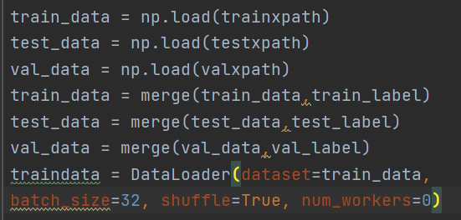
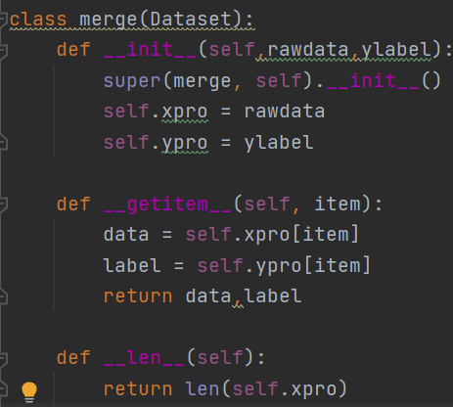
Ⅳ: Data processing
4.3 before input into model:
Before inputting into the model, the data in the NPY file should be loaded first, and the images and labels should be mapped one by one through fusion, so as to facilitate the disorder of the sequence during training and ensure the randomness of the training data.
Load data & merge & become a batch: class merge:

Slide 14
Ⅴ: Model introduction
Alexnet model is adopted in this experiment. Alexnet has 60 million parameters and 65000 neurons, five layers of convolution, three layers of fully connected network, and the final output layer is 1000 channel softmax.
5.1 The reason of choosing the model
Alexnet has achieved excellent results in image recognition and classification, and can learn more rich high-dimensional image features. Alexnet has a deeper network structure and data enhancement function, which can reduce over fitting and improve generalization ability. Avoid CNN with many parameters falling into over fitting because of the size of the original data.
Secondly, alexnet introduces relu as the activation function. It is verified that the effect of relu is better than sigmoid in deep networks, and successfully solves the gradient dispersion problem of sigmoid in deep networks.
In addition, the dropout technology is added to randomly ignore some neurons to avoid over fitting the model. Dropout is used in the last fully connected layers of Alexnet.
Pooling adopts overlapping maximum pooling, which avoids the fuzzy effect of average pooling. Moreover, the step size of pooling is smaller than the core size, which makes the outputs of pooling layers overlap and cover, and improves the richness of features.

Slide 15
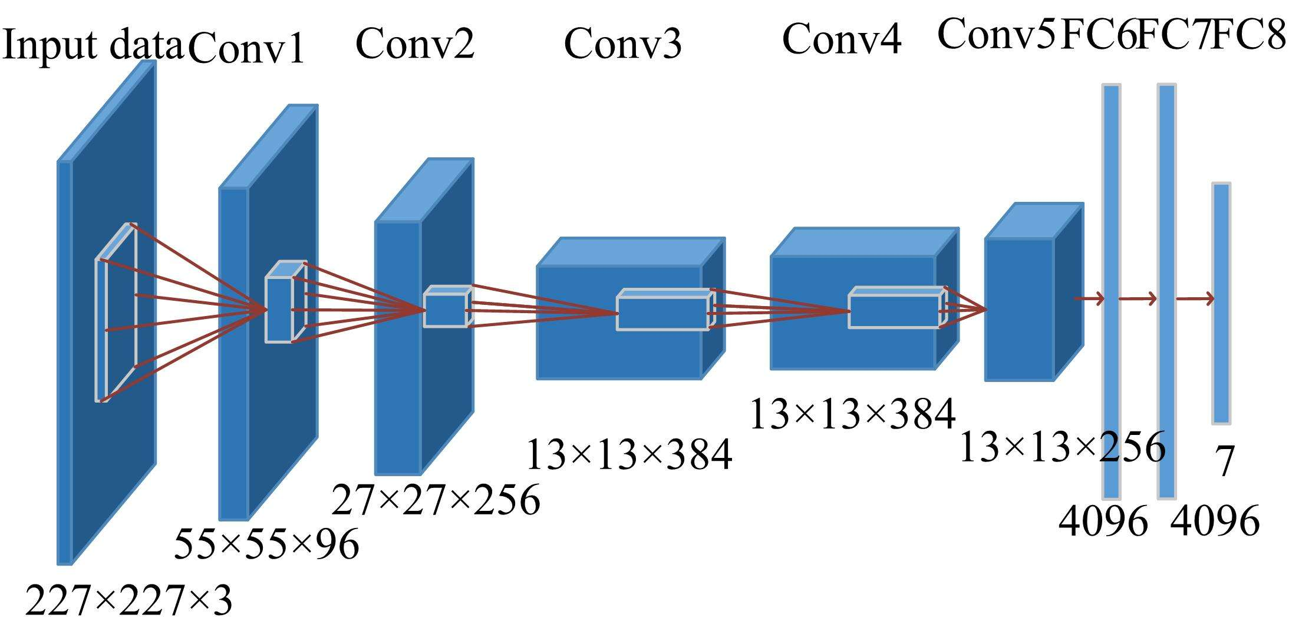
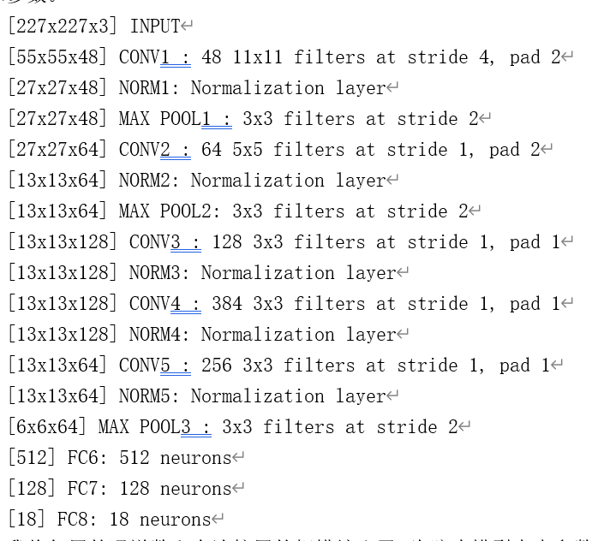
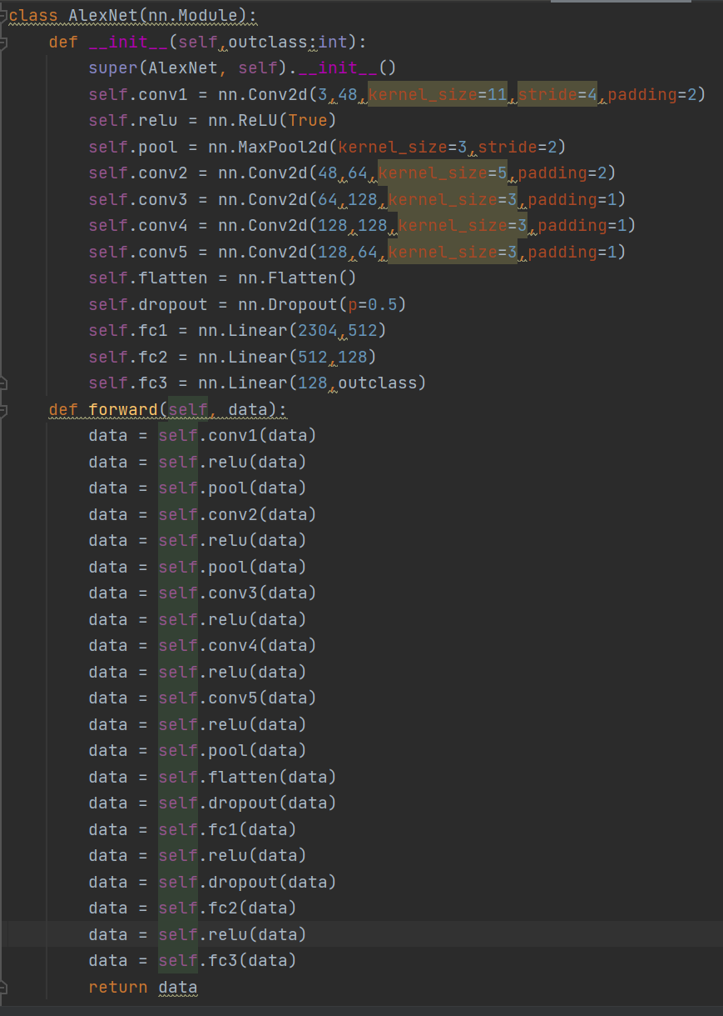
Ⅴ: Model introduction
The left is the schematic diagram of the model. Since the experimental data output is an 18 dimensional vector, the number of channels per layer and the number of full connection vectors are correspondingly reduced. The following figure is the model and parameters I designed based on the alexnet model. Code👇
5.2 Model structure
The network consists of 8 weighted layers; The first five layers are convolution layers, and the remaining three layers are full connection layers. The last layer is the output of the full connection layer.

Slide 16
Ⅴ: Model introduction
5.3 Model composition
The network consists of 8 weighted layers; The first five layers are convolution layers, and the remaining three layers are full connection layers. The last fully connected layer is output. Input 227*227*3 images, and the convolution result of the first layer is 55*55*48. The activation function of each layer adopts relu (), which will make the output of some neurons 0. This will cause the sparsity of the network, reduce the interdependence of parameters, and alleviate the problem of over fitting.
And relu is a linear output; In back propagation, SIGMOD has an exponential operation, while relu has an output part, and the derivative is always 1.
In the pooling layer, the pooling used by alexnet is maxpooling, and the pooling can be overlapped. Each layer of alexnet is pooled differently, but each time the pooled move step is 2, there will be overlap. Overlapping pooling can avoid over fitting.
In the FC layer, there is dropout between the two adjacent layers of FC. In the neural network, dropout is realized by modifying the structure of the neural network itself. For a neuron in a certain layer, the neuron is set to 0 through the defined probability, and the neuron will not participate in the forward and backward propagation, just like being deleted in the network, while keeping the number of neurons in the input layer and the output layer unchanged.
Then the parameters are updated according to the learning method of neural network. In the next iteration, some neurons are randomly deleted again (set to 0) until the end of training.

Slide 17
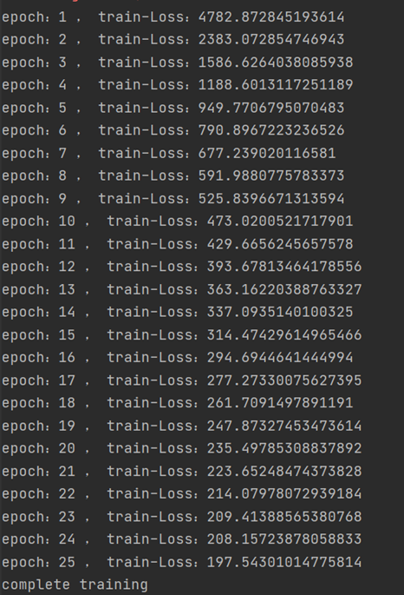
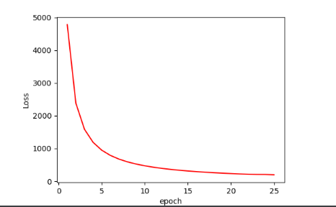
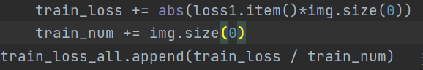
Ⅵ: Experimental result analysis
The number of epochs in this experiment was 25, and the learning rate was 0.0001. The number of iterations and learning rate are determined according to the measured results of different hyperparameters. Too few epochs have poor training effect, and too many will be overfitting.
Loss-epoch curve
value
The figure shows the specific data of the loss value after 25 training times. It can be found that the training result finally stabilized at about 200. Although it is still declining, the decline has been small. Many experiments have shown that there is a fitting risk in continuing training. The sharp decrease of loss in the early stage can also reflect that the model learning effect is very good and the loss decreases rapidly.
Calculating process of average loss

Slide 18
Ⅵ: Experimental result analysis
Now, let’s check some picture to evaluate the model and project
Introduction: The red dot in the following picture is the coordinate of the real point given in the label, and the green dot is the prediction result. The prediction result passes through sofmax when the model is output, and the values are all (-1,1). Therefore, I decoded the output data by multiplying 113 and adding 113. The purpose of this is to decode the data to between (0—227) and match the size of the picture. In addition, I have shown the specific real value and predicted value under each picture. The first two lines are the real value, and three or four lines are the predicted value. The first and third rows are horizontal axis coordinates, and the second and fourth rows are vertical axis coordinates. These pictures are taken from the last epoch of the training set and the first data of each batch. Batch is out of order.

Slide 19
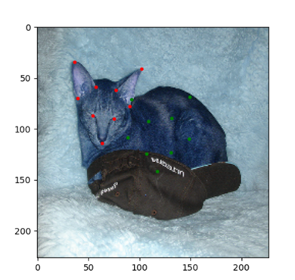
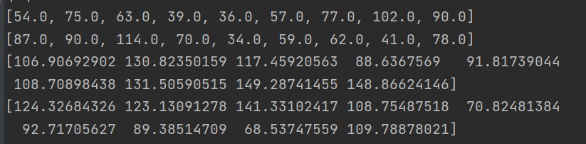
Ⅵ: Experimental result analysis
In this example, although the red points and green points do not match well, that is, the Euclidean distances of the two vectors are not close. But the relative position corresponds perfectly. It can be seen that through the results of model training, we learned the relative position of the picture mark points, that is, the relative position of the cat's eyes, mouth and ears.

Slide 20
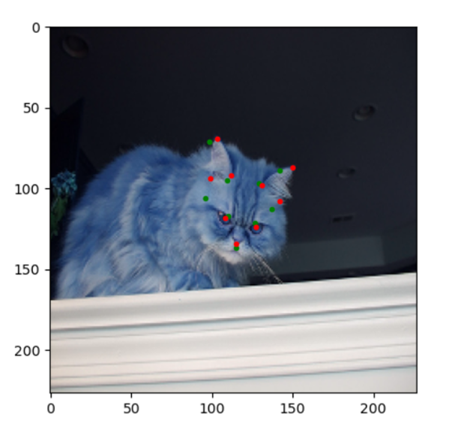
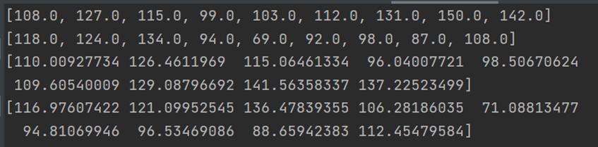
Ⅵ: Experimental result analysis
The matching effect of the above figure is good. It can be seen from the following numerical comparison and distance comparison, or directly from the red and green dot distribution of the picture.

Slide 21
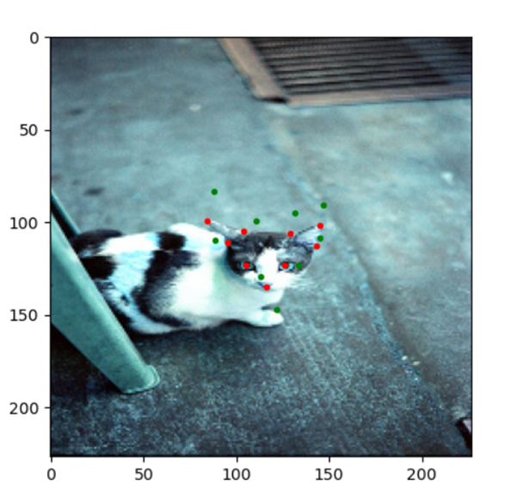
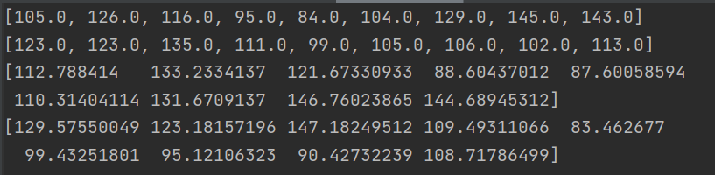
Ⅵ: Experimental result analysis
The matching effect of the above figure is good. It can be seen from the following numerical comparison and distance comparison, or directly from the red and green dot distribution of the picture.

Slide 22
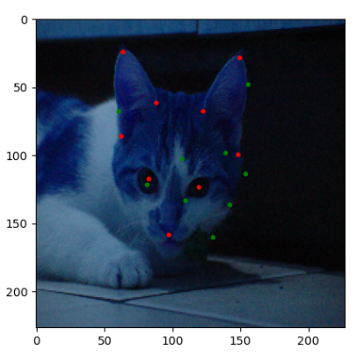
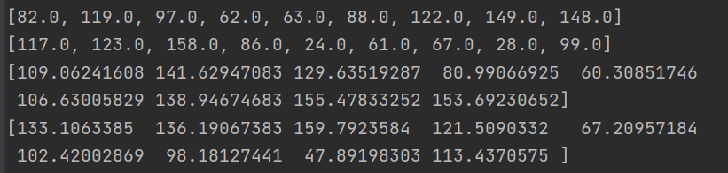
Ⅵ: Experimental result analysis
In this example, although the predicted position does not coincide with the label position, the relative position of the predicted point is very similar to the label position. Looking carefully at the ears, the characteristics of the three points of the two ears are learned well.

Slide 23
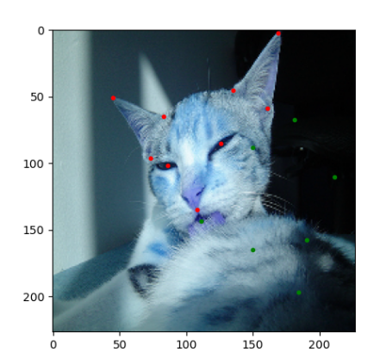
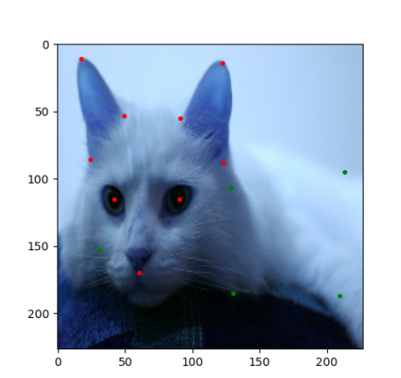
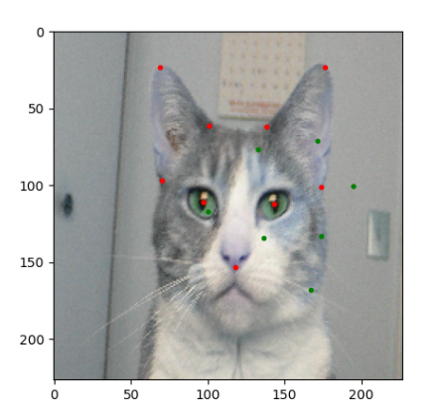
Ⅵ: Experimental result analysis
Bad examples: why bad?
Deduction: closed to the picture boundary?, relatively longer distance between different points?

Slide 24
Ⅶ: Conclusion and outlook
Questions I met:
① At first, I didn't know how to correspond the picture and label in a variable. Then, by consulting the materials and other people on the Internet, I learned to write my own class to merge the variables and load them through the dataloader.
② This is the first time for me to write a CNN model. Although I have learned the theory of CNN before, it is still unfamiliar to do it based on pytorch. By referring to other model writing methods, I designed a model myself and learned def__ init__ How to apply () and def forward () methods in neural network model.
③ Since the output of the model is the result of softmax, and my label is not normalized, I want them to establish a mapping relationship to better train. Then I refer to the encoding and decoding method, through linear decoding, the output data is inversely normalized, and then the loss is calculated to train the network.

Slide 25
Ⅶ: Conclusion and outlook
Significance of the topic and my harvest
Through this subject, I am familiar with the basic process of machine learning, including data processing, data loading, model building, calculation results, back propagation; Verification and testing, and visual inspection. I didn't know every step at first. I learned how to implement each step by checking the data, such as how to read and write pictures, how to build models, how to run programs on GPU, and so on. This assignment has stimulated my interest in machine learning. In the future, I can optimize my model to achieve better results on the basis of generality.

Slide 26
THANKS FOR LISTENING END

